Slide 1
UNIC Meeting Faculties?
Date?
Agenda:
Introduction round
Plenary session
Breakout rooms

Slide 2
Philology, Comparative literature, Ruhr-Universität Bochum
The Department of Comparative Literature in Bochum is part of the Faculty of Philology. The faculty has a total of approx. 9,000 students, the institute itself 600 students.
There are 3 professors and about 4 other permanent staff working at the institute.

Slide 3
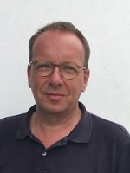
Philology, Comparative literature, Ruhr-Universität Bochum
In Comparative Literature, Prof. Dr. Peter Gossens is currently working on the topics mentioned by Koç University.
Research focus
World literature (as a literary phenomenon from antiquity to the present day, across the world)
World literature studies as a scientific concept. (also historically 18-21st century)
Academic history of comparative literature
Translation studies and literary translation
Postcolonial studies / Orientalism
Literature of the Holocaust (e.g. Paul Celan)
Contact: Prof. Dr. Peter Gossens, Ruhr-Universität Bochum, Komparatistik, Universitätsstr. 150, GB 2/144, 44780 Bochum peter.gossens@rub.de

Slide 4
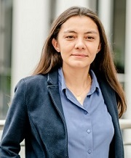
Philology, Comparative literature, Ruhr-Universität Bochum
In Comparative Literature, Prof. Dr. Peter Gossens is currently working on the topics mentioned by Koç University.
In view of the research interests of the University of Koç, the following RUB colleagues would also be interested in working together:
Jun. Prof. Hülya Çelik, Turkology / Oriental Studies, has already been in contact with colleague Mehmet Fatih Uslu in Koç.

Slide 5
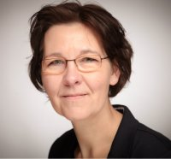
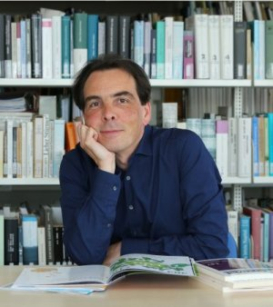
Philology, Comparative literature, Ruhr-Universität Bochum
In Comparative Literature, Prof. Dr. Peter Gossens is currently working on the topics mentioned by Koç University.
In view of the research interests of the University of Koç, the following RUB colleagues would also be interested in working together:
Jun. Prof. Hülya Çelik, Turkology / Oriental Studies, has already been in contact with colleague Mehmet Fatih Uslu in Koç.
PD Dr. Kristin Platt
Dr. Medardus Brehl
Both are at the Institute for Diaspora and Genocide Research and have a focus there on the Armenian Genocide, among other things.

Slide 6
Philology, Comparative literature, Ruhr-Universität Bochum
Research cooperation desired:
In principle, all four participants would be interested in cooperations on the above-mentioned topics in whatever form.

Slide 7
Philology, Comparative literature, Ruhr-Universität Bochum
Existing mobility formats and experience:
Various ERASMUS partnerships
Double-Degree with the University of Bergamo

Slide 8
Philology, Comparative literature, Ruhr-Universität Bochum
Teaching/Exchange cooperation desired (formats/topics):
In principle, all four participants would be interested in cooperations on the above-mentioned topics in whatever form.
Two things could be a problem here:
Most of the events at the Institute for Comparative Literature are held in German
The semester times in Germany unfortunately do not correspond to international standards.

Slide 9
Philology, Comparative literature, Ruhr-Universität Bochum
Open Courses for summer semester
Prof. Dr. Peter Gossens
Benjamin und Baudelaire (A2, A3, A5, V5), Mo 16:00h - 18:00h, Start 11.4.2022
Babylon Berlin. Die ‚Goldenen Zwanziger‘ im 21. Jahrhundert (A1, V4, A5, V6), Tue 16:00h - 18:00h. Start 12.4.2022
Both events are also offered as hybrid events.

